Slide 1

“ DATA PIPELINE ”
Final Evaluation
Presenter :- Iftisam Tariq
( 2021a1l017 )
CSE-5th semester
DEPARTMENT OF COMPUTER SCIENCE AND ENGINEERING
MIET(Autonomous), JAMMU

Slide 2
Contents :
Internship Learning Outcomes
Project : Data Pipeline
Introduction
Problem Statement
Solution
Features
Tech Stack
Workflow
Demonstration
References

Slide 3

Internship Learning Outcomes
Core of the Python Programming-
Datatype
Variables
Type casting
Operators
Statements(Conditional,Transfer & Iterative)
Functions
Arguments
File handling & OOps
Data Exploration
Working With
NumPy And Pandas

Slide 4
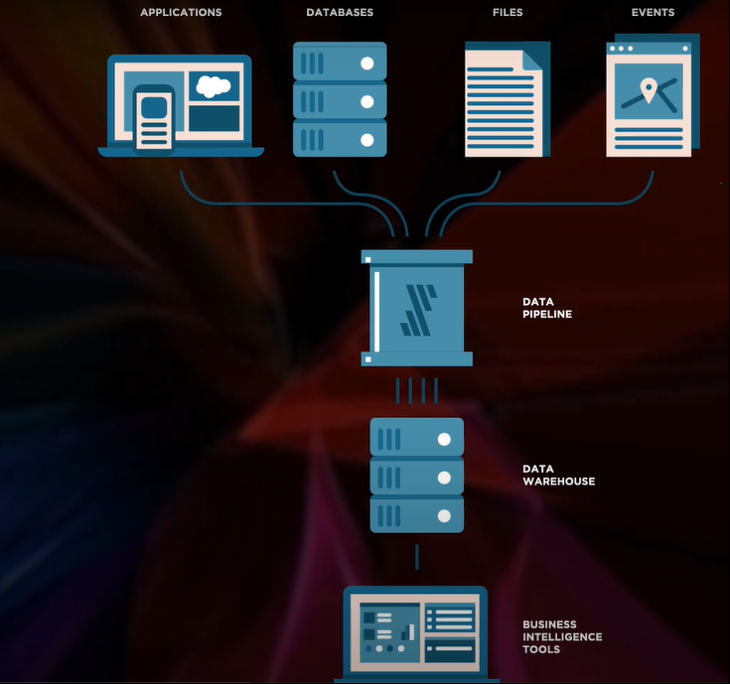



Project : Data Pipeline
WHAT IS DATA PIPELINE ?
It is a series of tools and actions for organizing and transferring the data to different storage and analysis systems , it automates the ETL process i.e. extraction transformation load as a data pipeline.
E.g.- You can collect information about your customer’s device location and session duration and track their purchases and interaction with your brand’s customer service.
Applications
Database
Data
Pipeline
Data
Warehouse
Business
Intelligence
Tools
Files

Slide 5
HOW DOES A PIPELINE WORKS ?
The raw unstructured data is located at the beginning of the pipeline , then it passes a series of steps and each of them transforms the data .
DATA PIPELINE
Collecting The Data
Extraction
Transformation
Destination
Monitoring
1. 2. 3. 4. 5.

Slide 6
…
Collecting The Data -
The system gathers the raw data from the sources , such as databases. E.g. From MySQL.
Extraction -
After the raw data is collected, the system starts reading the data .
Transformation -
Adjusting the structure or format of the data.
Destination -
Final point where the clean data is transferred , further they can go to data warehouses.
Monitoring -
It is use to ensure that the data is accurate.

Slide 7
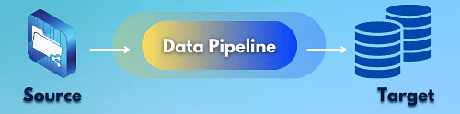
Problem Statement :
Sometimes it can be quite challenging to maintain the right records and backups of a company or a client while dealing with data.
Picking up the data on daily basis and the need to store it on different layers.

Slide 8
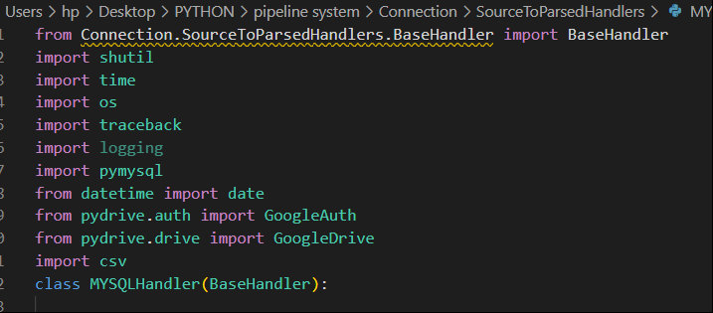




Solution Statement :
Python script that uses the pipelining principle to load data from MySQL and save it on the local drive as CSV file and same as to Google drive.

Slide 9
LANGUAGE & LIBRARIES USED:
Language :- Python
Python Libraries / Modules:-
1. Shutil -
Syntax : import shutil
(Used for transferring files)
2. Time -
Syntax : import time
(To work with all time related functions)
3. Os -
Syntax : import os
(Provides functions for interacting with the operating system)
4. Traceback -
Syntax : import traceback
(Provides key to resolve unhandled exceptions that occur during the execution of a python program)

Slide 10
…
5. Logging -
Syntax : import logging
(Used to track when the program is running)
6. PyMySQL -
Syntax : import pymysql
(Provides an interface for connecting to MySQL database server from python)
7. CSV -
Syntax : import csv
(Used for parsing tabular like data structure such as data in excel format & these files are saved in csv extension)
8. google-auth -
Syntax : import GoogleAuth
(Provides the ability to authenticate Google APIs using various methods)

Slide 11
Features :
Complete pipeline solution for ETL ( Extract, Transform & Load ) process.
Real time problem statement.
Allows you to handle and analyze vast quantities of data in much less time.
EXTRACT
TRANSFORM
LOAD
DATA PIPELINING END TO END FLOW

Slide 12



Tech Stacks :
SQL
Python
Google Cloud

Slide 13
Workflow :
SOURCE
LANDING LAYER
PARSING LAYER
Daily Data
from
MySQL
Local
Storage
Google Drive
“Daily Data Pipeline”

Slide 14

Demonstration :
After signing in google cloud console , build a project of your choice, and then -

Slide 15
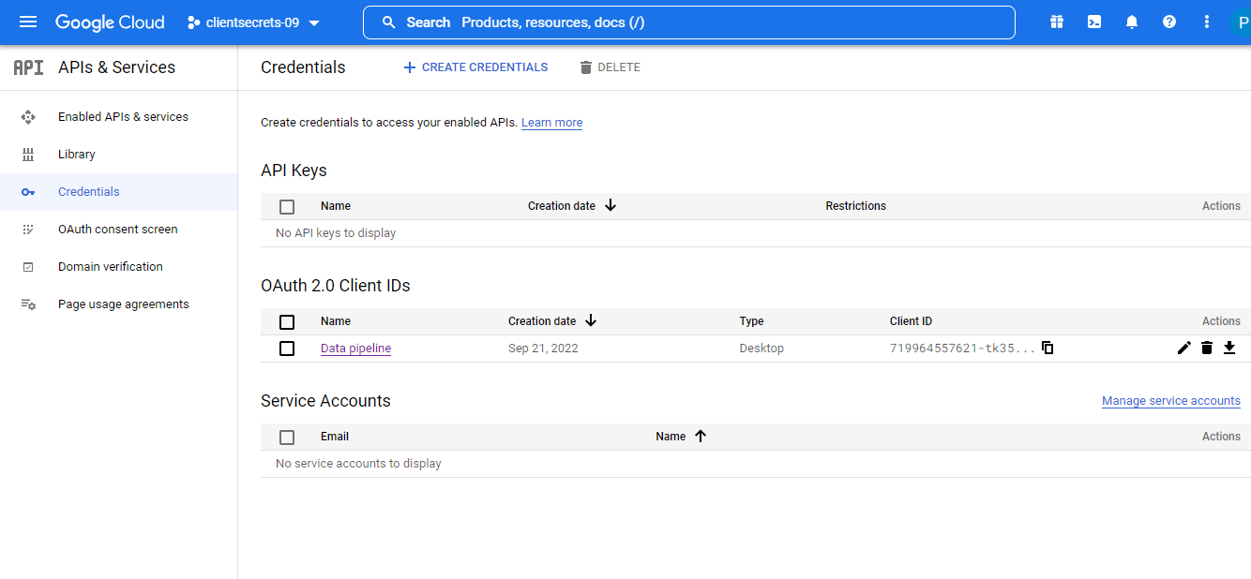
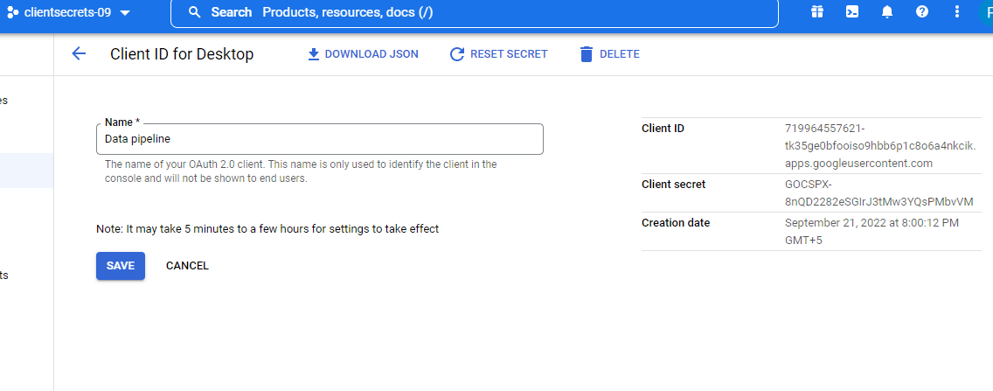
Work on google cloud -
Create credentials to access your enabled APIs.
Client ID for making connection in data pipelining.

Slide 16
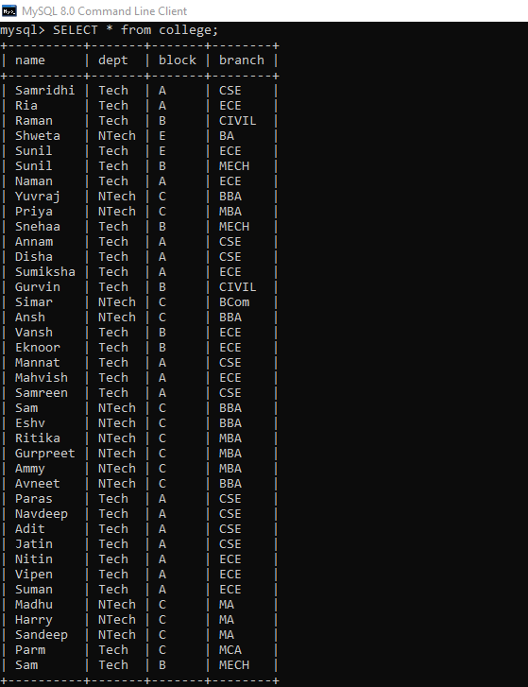
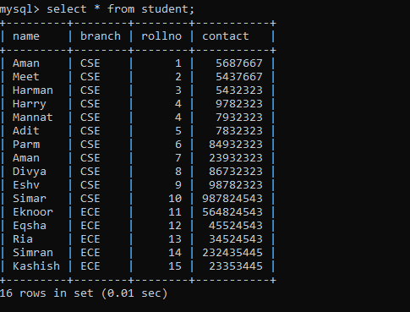
Data from Source -
For eg. We received data from some other company in SQL. This data needs to be stored in our system and google drive, so that business intelligence team picks the data in accordance to their needs.

Slide 17
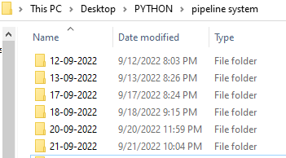
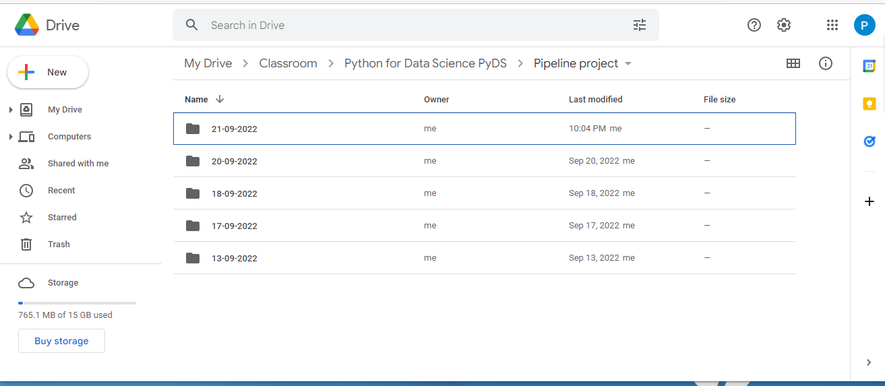
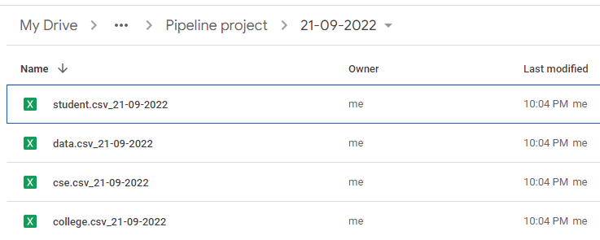
Output Screenshots :
After running the main code , data from the SQL source will get saved in our system and in the linked google drive in the form of an excel-sheet.

Slide 18
References:
Data Pipeline- Definition, Architecture, Examples, and Use Cases (projectpro.io)
https://www.bing.com/images/search
Data Pipeline- Definition, Architecture, Examples, and Use Cases (projectpro.io)
Google Cloud console
WHAT IS DATA PIPELINE? | BEST TOOLS FOR OPERATIONS WITH DATA PIPELINES - YouTube
https://www.geeksforgeeks.org/

Slide 19


